Slide 1
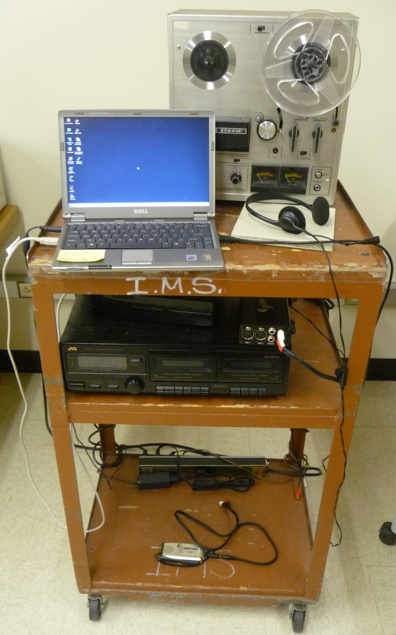
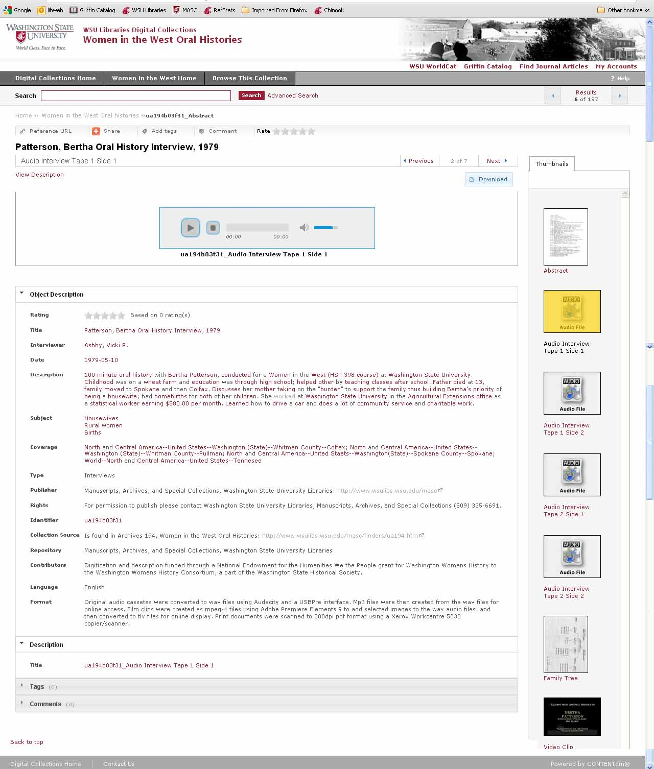
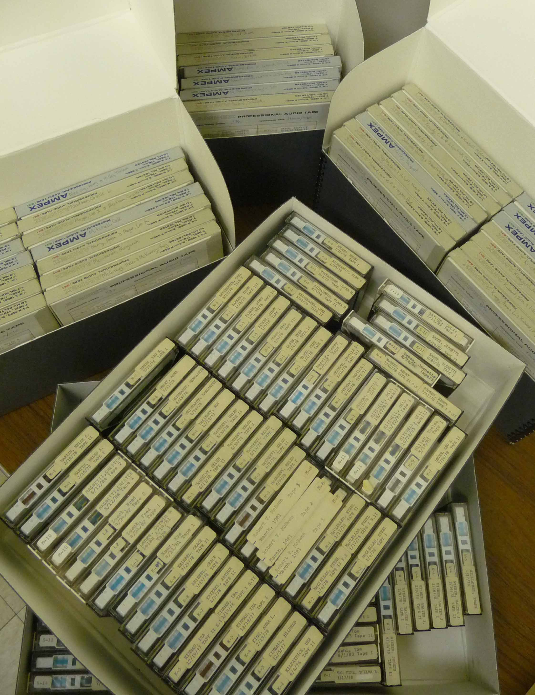
MORE PRODUCT, LESS EFFORT: COST-EFFECTIVE AUDIO DIGITIZATION
Katrina Burch, 2012 MLIS, San Jose State University; Mark O’English, University Archivist, Washington State University
Manuscripts, Archives, and Special Collections (MASC), Washington State University Libraries
The digitization station at the Washington State University Libraries’ Manuscripts, Archives, and Special Collections (MASC) was created in order to more efficiently work through audio material. During 2011, MASC digitized over 600 hours of cassettes, micro-cassettes, and reel-to-reels. Audio digitization requires only five employee minutes of attention per recording, and so fifty hours of student labor equaled 600 hours of audio.
In 2011, we digitized 360 hours of oral histories from a 1980 Whitman County Historical Society project, and 240 hours of oral histories from WSU’s 1970-2005 “Women in the West” history classes. These materials were captured from multiple physical audio formats and preserved as wav files.
PORTABLE AUDIO DIGITIZATION STATION
The process for digitization may vary by format; however, it can be fairly standardized. At the simplest level, start the capture process, play the audio, and when that audio is finished, crop “dead air” from the start and end. Some formats require more work; reel-to-reels can contain multiple tracks which may require slight file manipulations to parse.
The MASC originally conducted audio digitization on a combined audio/video media digitization station, but processing demands for video meant we could not do multiple processes at once. As video requires constant attention and can be exceedingly time consuming (frequently three to four times the length of the video), we moved the audio processes. As audio requires minimal time involvement and smaller equipment, we created a portable station so any student timeslip worker could do audio digitization from any workspace, while they conducted other projects.
CASSETTES & REEL-TO-REELS
Not only was the station cost effective for work effort, it was also cost effective because of the materials used. The digitization program, Audacity, is freeware and easy to use. All other equipment used were pieces that MASC had in its possession, or was able to scavenge elsewhere in the Libraries.
COMPOUND OBJECT IN ONLINE DIGITAL COLLECTION
AUDACITY
Simplified audio digitization has allowed us to enhance how and what we communicate to our students and researchers. Simply having the capacity to do this has led not only to creation of greater digital resources, but to spending more time exploring our backfiles. We’ve “discovered” audio from 1960s-era student protests, commencement speakers like Gary Larson and Edward R. Murrow, and racism workshops conducted in 1970, and have used these to enhance our media presence in online communities.
One audio digitization challenge arises from the age of the necessary equipment. Reel-to-reel players tend to moderately scarce and be over 40 years old, with resultant age-related problems.. The reel-to-reel tapes themselves are almost always still in good shape/quality. Cassettes have the opposite issue – while cassette decks tend to be in the 20 year old range and work well (and replacements are easily scavenged), the tapes themselves are degrading, with either poor quality sound or the cassettes themselves breaking. Microcassettes are even worse, with the noise of the players and their power sources drowning the audio.

